Slide 1

Database Management System for
Shreya Imitation Jewellery
By :- Sumit Sanjay Deokar

Slide 2

Powered by a smart SQL Database Management System,
we manage:
Accurate stock updates
Fast and secure billing
Customer records and purchase history
Employee and supplier management
Our shop offers a wide collection of imitation jewellery — from daily wear to festive specials — ensuring style, quality, and value.
All handled efficiently through a reliable and automated platform, making business operations smooth and error-free.

Slide 3
Features:
Product stock tracking
Customer billing & sales reports
Employee details management
Automated alerts & triggers
Solution →SQL Database Management System
At Shreya Imitation Jewellery, daily sales, stocks , customers and employees need to be managed.

Slide 4

Objectives
Maintain accurate stock of ornaments
Record customer billing history
Automate daily sales entries
Use Stored Procedures, Functions, Triggers
Ensure no negative stock

Slide 5
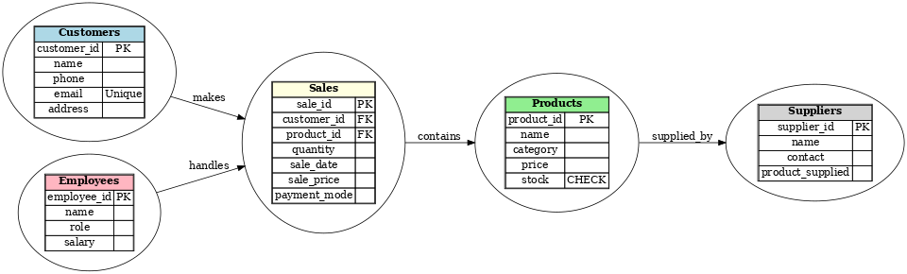
ER – Diagram

Slide 6
📊 Our Jewellery Shop Database contains well-structured tables to manage daily operations:
Customers Table | Stores customer details (Name, Contact, City).
Products Table | Maintains jewellery items, category, price, stock.
Sales Table | Records customer purchases, bill amounts, payment type.
Employees Table | Employee details, roles, and salary.
Suppliers Table | Information about gold/silver suppliers
These tables are linked through Primary & Foreign Keys to ensure data integrity.

Slide 7

Table Description

Slide 8
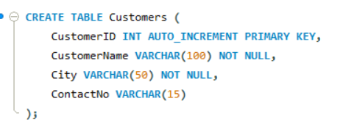
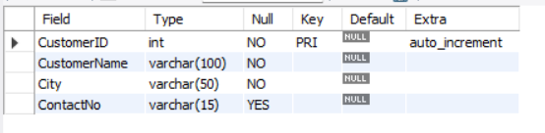
Customers Table

Slide 9
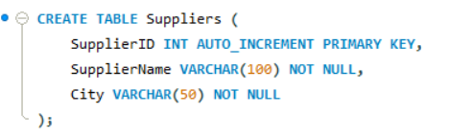
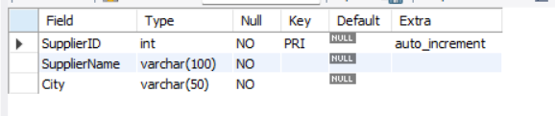
Suppliers Table

Slide 10
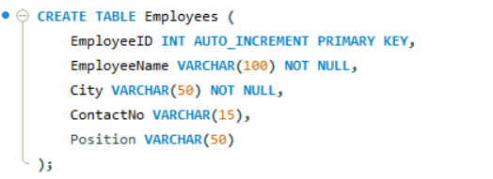
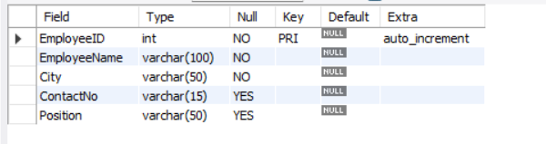
Emplooyes Table

Slide 11
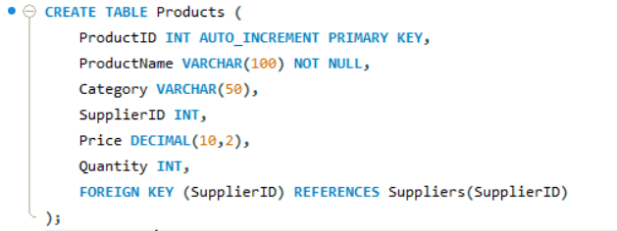
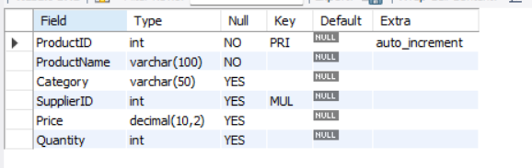
Products Table

Slide 12
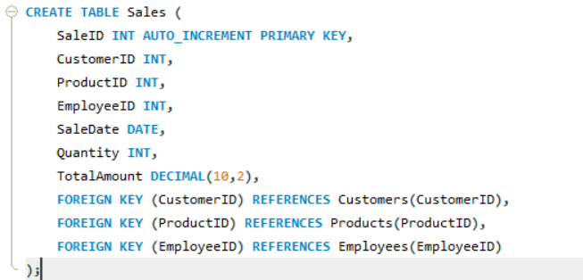
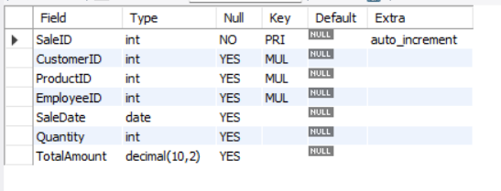
Sales Table

Slide 13

2. Inserting Tables

Slide 14
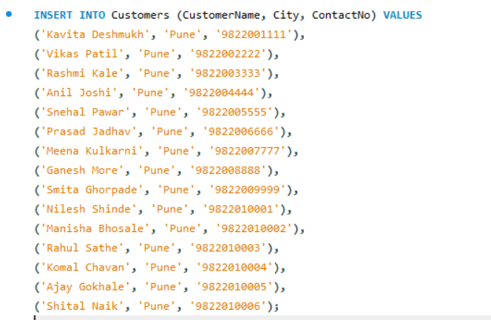
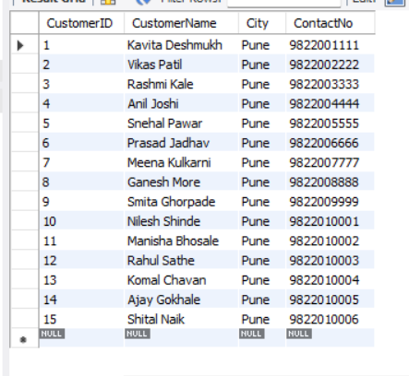
Inserting Into Customers Table

Slide 15
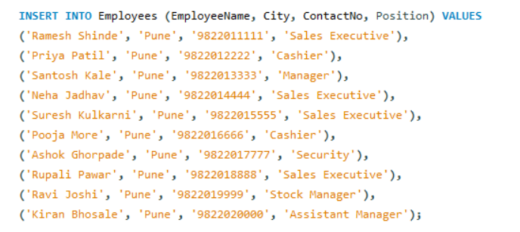
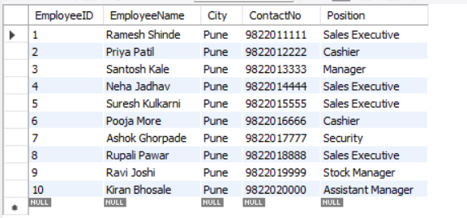
Inserting Into Employees Table

Slide 16
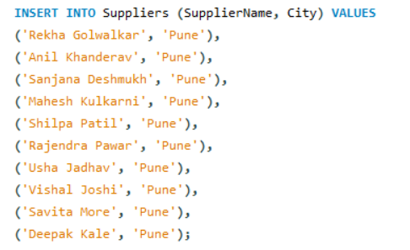
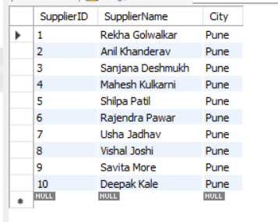
Inserting Into Suppliers Table

Slide 17
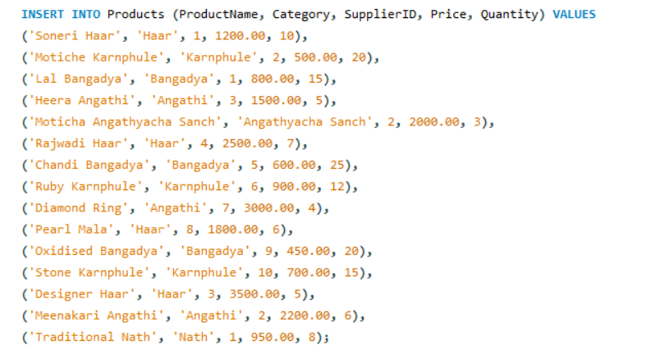
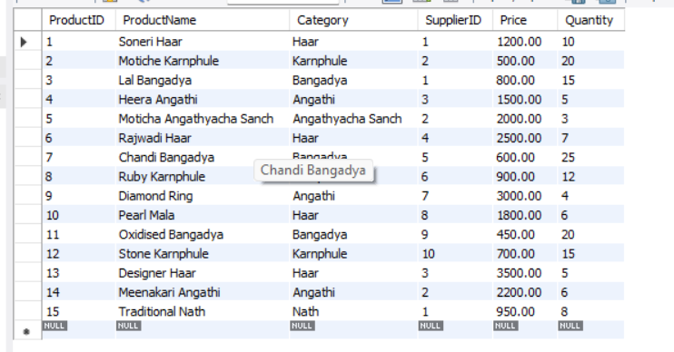
Inserting Into Products Table

Slide 18
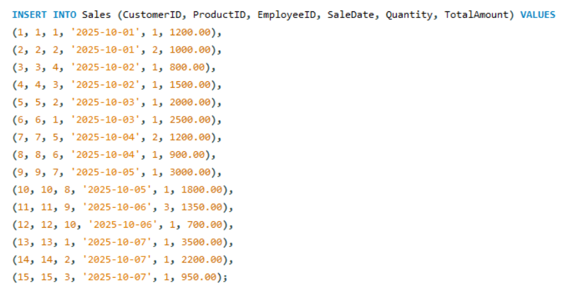
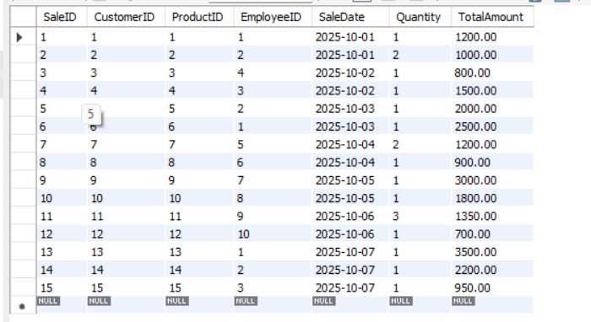
Inserting Into Sales Table

Slide 19
3. Performing DML Operations
Insert
Update
Delete

Slide 20
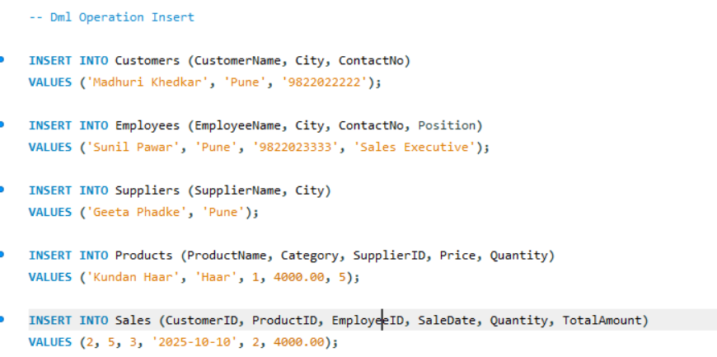
INSERTION

Slide 21
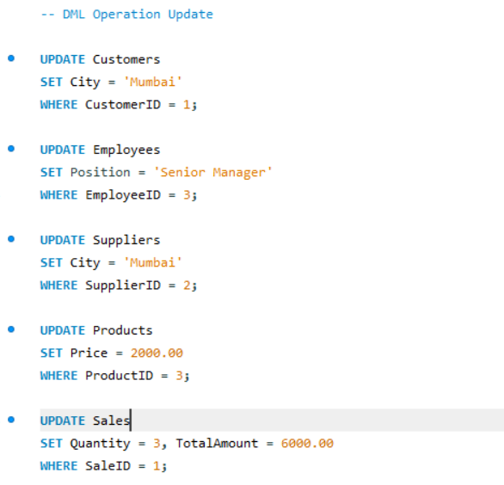
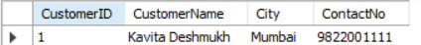
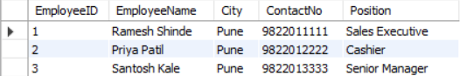
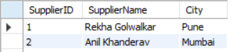
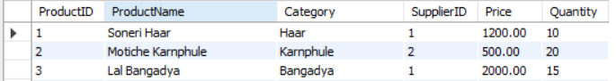
UPDATE

Slide 22
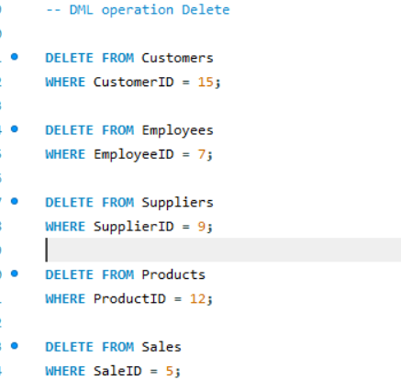
DELETE

Slide 23

CREATE
ALTER
RENAME
TRUNCATE
DROP
4 DDL OPERATIONS

Slide 24
CREATE OPERATION

Slide 25
ALTER OPERATION

